Slide 1
REAL ANALYSIS
PRESENTED BY
Dr.U.KARUPPIAH
DEPARTMENT OF MATHEMATICS

Slide 2
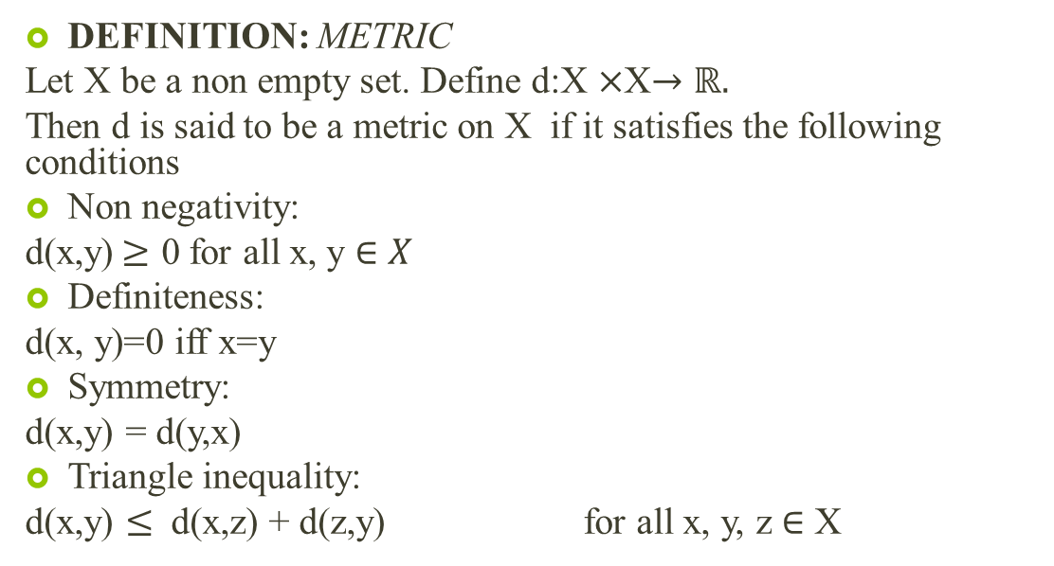
METRIC SPACE
DEFINITION:METRIC
Let X be a non empty set. Define d:X $×$X$→ℝ.$
Then d is said to be a metric on X if it satisfies the following conditions
Non negativity:
d(x,y)$≥$ 0 for all x, y $∈X$
Definiteness:
d(x, y)=0 iff x=y
Symmetry:
d(x,y) = d(y,x)
Triangle inequality:
d(x,y) $≤$ d(x,z) + d(z,y) for all x, y, z $∈$ X

Slide 3
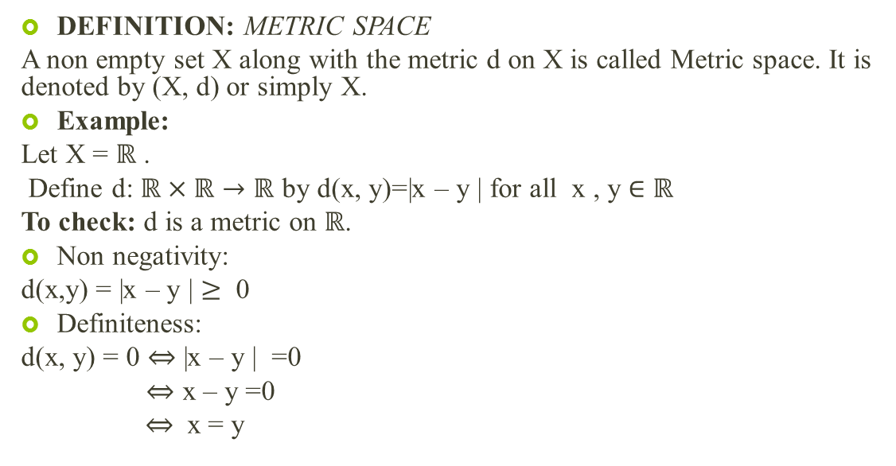
DEFINITION: METRIC SPACE
A non empty set X along with the metric d on X is called Metric space. It is denoted by (X, d) or simply X.
Example:
Let X = $ℝ$.
Define d: $ℝ×ℝ→ℝ$ by d(x, y)=|x – y | for all x , y $∈$$ℝ$
To check: d is a metric on $ℝ$.
Non negativity:
d(x,y) = |x – y | $≥$ 0
Definiteness:
d(x, y) = 0 $⇔$|x – y | =0
$⇔$ x – y =0
$⇔$ x = y

Slide 4

Symmetry:
d(x, y) = |x – y |
= | -(y – x)|
= |y- x |
= d(y , x)
Triangle inequality:
Consider d(x,y) = |x- y|
=| x –z + z – y |
= |(x-z) – (y-z)|
= |(x-z) + (z-y)|
$≤$ |x-z| + |z-y|
=d(x,z) + d(z,y) for all x, y, z $∈ℝ$

Slide 5
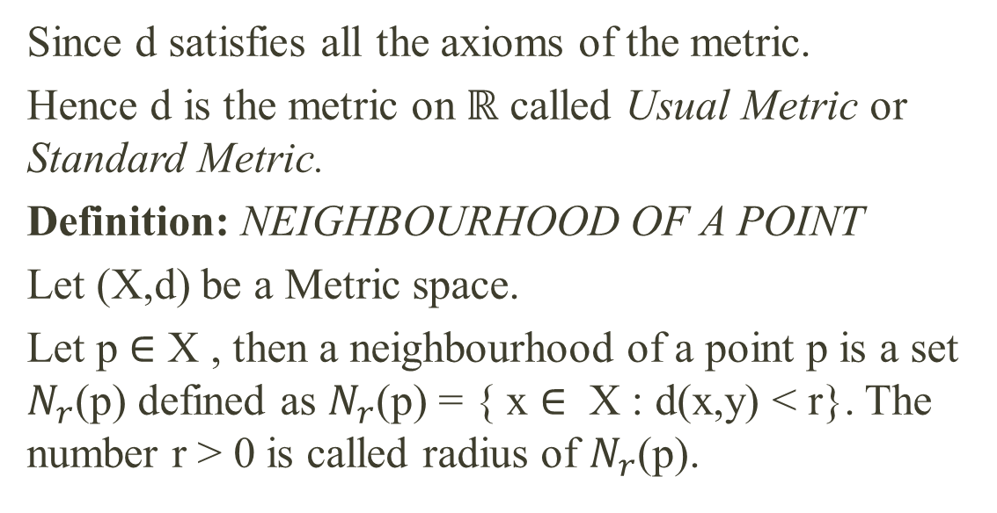
Since d satisfies all the axioms of the metric.
Hence d is the metric on $ℝ$ called Usual Metric or Standard Metric.
Definition: NEIGHBOURHOOD OF A POINT
Let (X,d) be a Metric space.
Let p $∈$X , then a neighbourhood of a point p is a set $N_{r}$(p) defined as $N_{r}$(p) = { x $∈$ X : d(x,y) < r}. The number r > 0 is called radius of $N_{r}$(p).

Slide 6
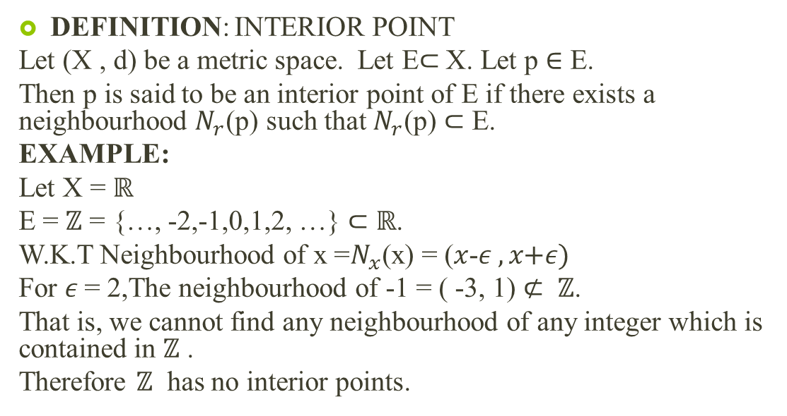
DEFINITION: INTERIOR POINT
Let (X , d) be a metric space. Let E$⊂$X. Let p $∈$ E.
Then p is said to be an interior point of E if there exists a neighbourhood$N_{r}$(p) such that $N_{r}$(p) $⊂$ E.
EXAMPLE:
Let X = $ℝ$
E = $ℤ$ = {…, -2,-1,0,1,2, …}$⊂$$ℝ$.
W.K.T Neighbourhood of x =$N_{x}$(x) = ($x$-$ε ,x\text{+}ε)$
For $ε$= 2,The neighbourhood of -1 = ( -3, 1) $⊄ ℤ$.
That is, we cannot find any neighbourhood of any integer which is contained in $ℤ$.
Therefore $ℤ$ has no interior points.

Slide 7
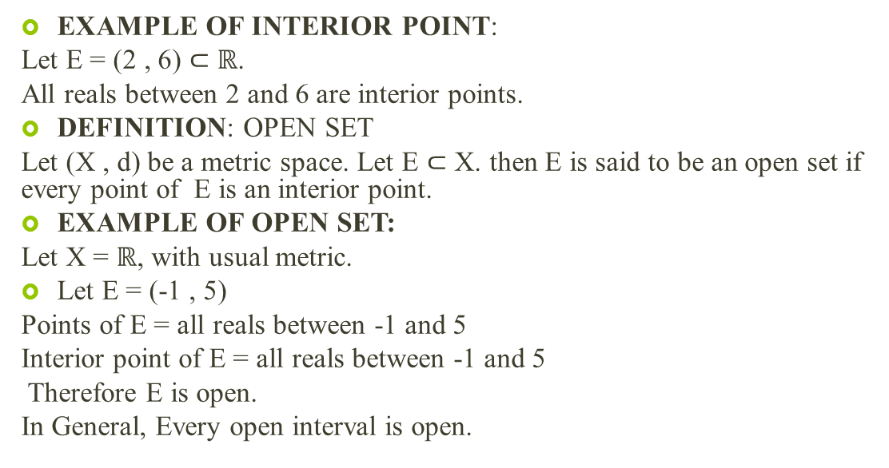
EXAMPLE OF INTERIOR POINT:
Let E = (2 , 6) $⊂$$ℝ$.
All reals between 2 and 6 are interior points.
DEFINITION: OPEN SET
Let (X , d) be a metric space. Let E $⊂$X. then E is said to be an open set if every point of E is an interior point.
EXAMPLE OF OPEN SET:
Let X = $ℝ$, with usual metric.
Let E = (-1 , 5)
Points of E = all reals between -1 and 5
Interior point of E = all reals between -1 and 5
Therefore E is open.
In General, Every open interval is open.

Slide 8
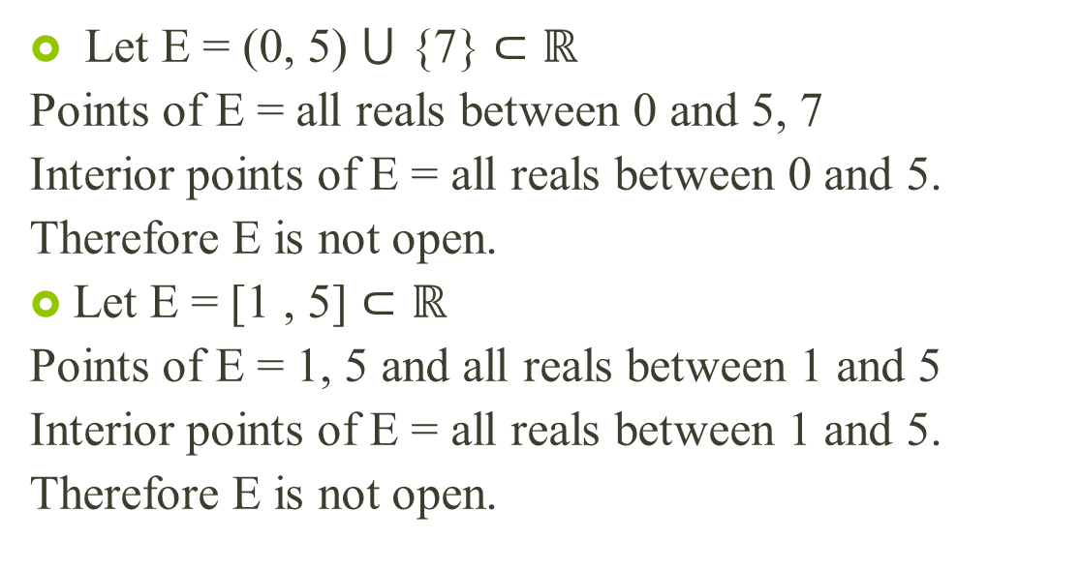
Let E = (0, 5) $⋃$ {7} $⊂ℝ$
Points of E = all reals between 0 and 5, 7
Interior points of E = all reals between 0 and 5.
Therefore E is not open.
Let E = [1 , 5]$⊂ℝ$
Points of E = 1, 5 and all reals between 1 and 5
Interior points of E = all reals between 1 and 5.
Therefore E is not open.

Slide 9
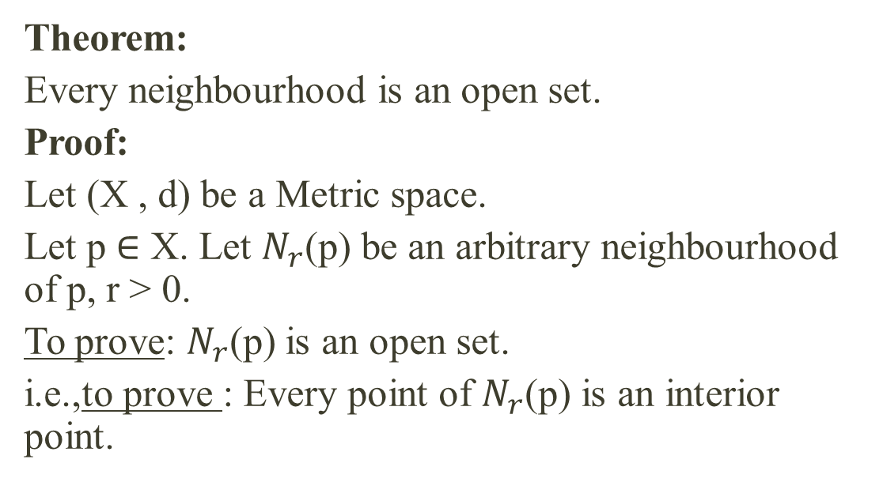
Theorem:
Every neighbourhood is an open set.
Proof:
Let (X , d) be a Metric space.
Let p $∈$X. Let $N_{r}$(p) be an arbitrary neighbourhood of p, r > 0.
To prove: $N_{r}$(p) is an open set.
i.e.,to prove : Every point of $N_{r}$(p) is an interior point.

Slide 10
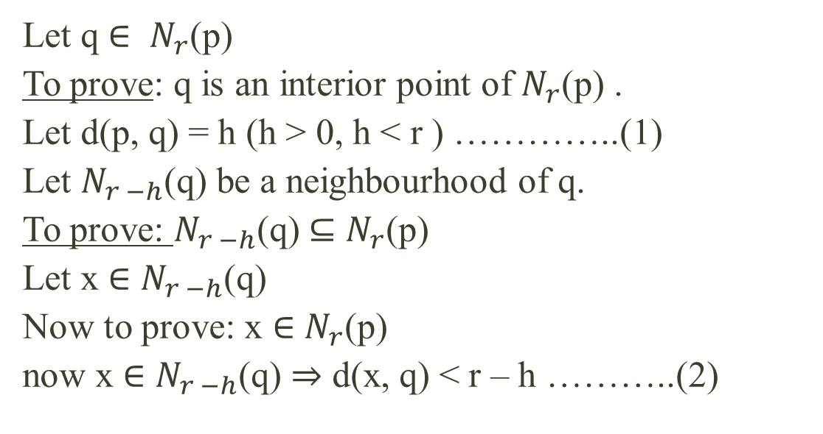
Let q $∈ N_{r}$(p)
To prove: q is an interior point of $N_{r}$(p) .
Let d(p, q) = h (h > 0, h < r ) …………..(1)
Let $N_{r −h}$(q) be a neighbourhood of q.
To prove: $N_{r −h}$(q) $⊆$$N_{r}$(p)
Let x $∈$$N_{r −h}$(q)
Now to prove: x $∈$$N_{r}$(p)
now x $∈$$N_{r −h}$(q)$⇒$ d(x, q) < r – h ………..(2)

Slide 11
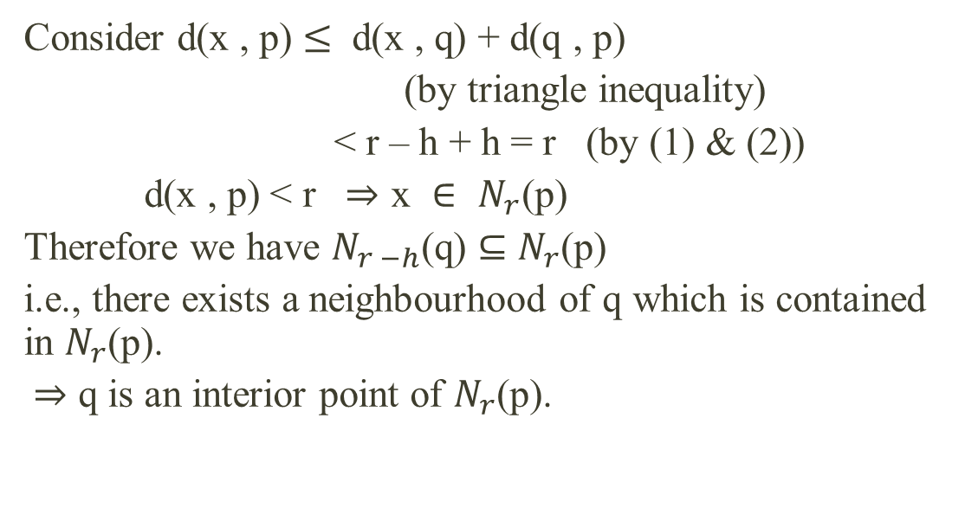
Consider d(x , p) $≤$d(x , q) + d(q , p)
(by triangle inequality)
< r – h + h = r (by (1) & (2))
d(x , p) < r $⇒\text{x} ∈ N_{r}\text{(}\text{p}\text{)}$
Therefore we have $N_{r −h}$(q) $⊆$$N_{r}$(p)
i.e., there exists a neighbourhood of q which is contained in $N_{r}$(p).
$⇒$ q is an interior point of $N_{r}$(p).

Slide 12
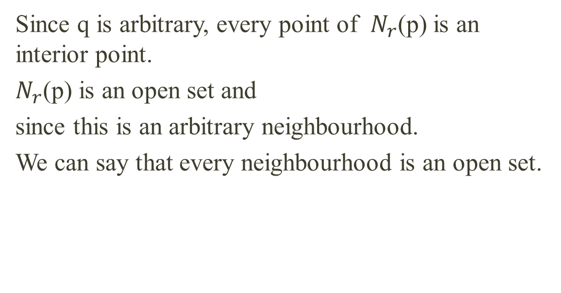
Since q is arbitrary, every point of $N_{r}$(p) is an interior point.
$N_{r}$(p) is an open set and
since this is an arbitrary neighbourhood.
We can say that every neighbourhood is an open set.

Slide 13
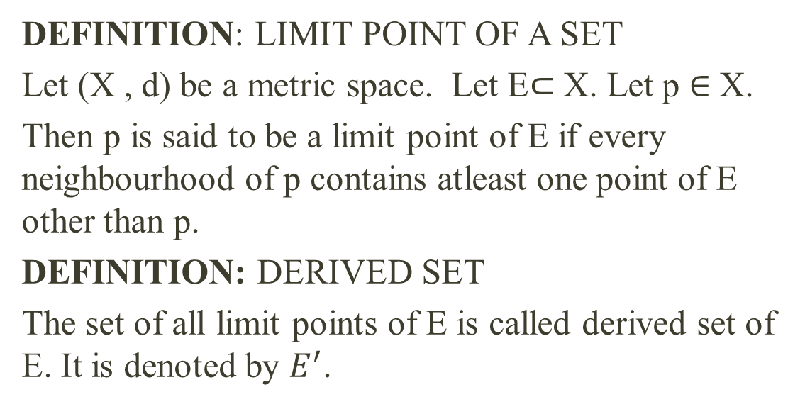
DEFINITION: LIMIT POINT OF A SET
Let (X , d) be a metric space. Let E$⊂$X. Let p $∈$ X.
Then p is said to be a limit point of E if every neighbourhood of p contains atleast one point of E other than p.
DEFINITION: DERIVED SET
The set of all limit points of E is called derived set of E. It is denoted by $E^{′}$.

Slide 14
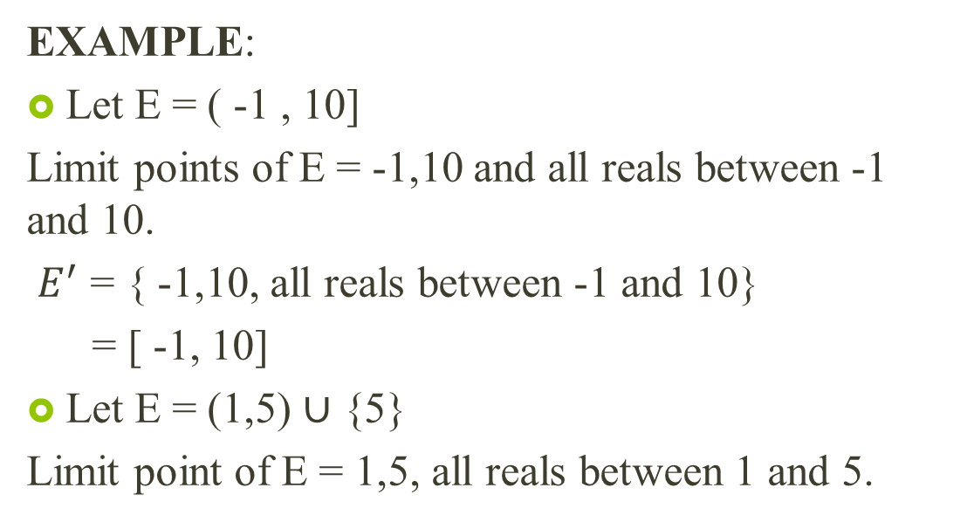
EXAMPLE:
Let E = ( -1 , 10]
Limit points of E = -1,10 and all reals between -1 and 10.
$E^{′}$ = { -1,10, all reals between -1 and 10}
= [ -1, 10]
Let E = (1,5) $∪$ {5}
Limit point of E = 1,5, all reals between 1 and 5.

Slide 15
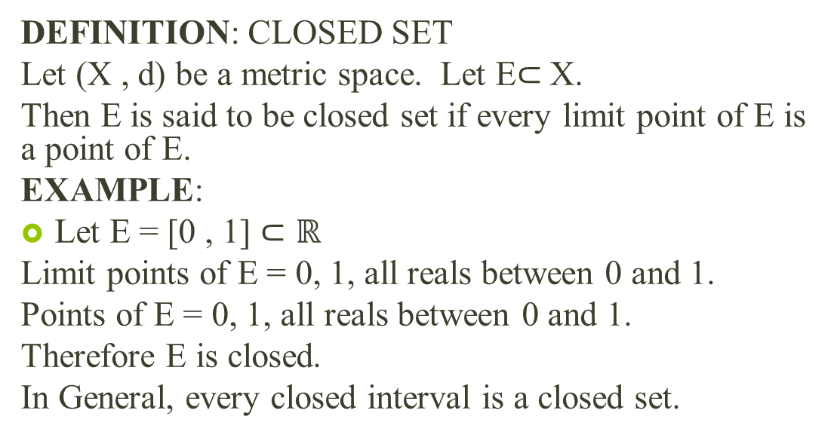
DEFINITION: CLOSED SET
Let (X , d) be a metric space. Let E$⊂$X.
Then E is said to be closed set if every limit point of E is a point of E.
EXAMPLE:
Let E = [0 , 1] $⊂ℝ$
Limit points of E = 0, 1, all reals between 0 and 1.
Points of E = 0, 1, all reals between 0 and 1.
Therefore E is closed.
In General, every closed interval is a closed set.

Slide 16
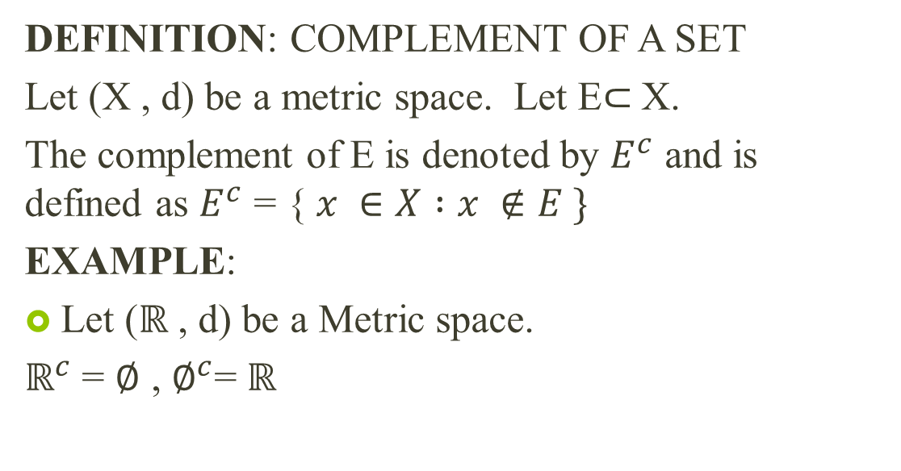
DEFINITION: COMPLEMENT OF A SET
Let (X , d) be a metric space. Let E$⊂$X.
The complement of E is denoted by $E^{c}$ and is defined as $E^{c}$= { $x ∈X :x ∉E \}$
EXAMPLE:
Let ($ℝ$ , d) be a Metric space.
$ℝ^{c}$ = $∅$ , $∅^{c}$= $ℝ$

Slide 17
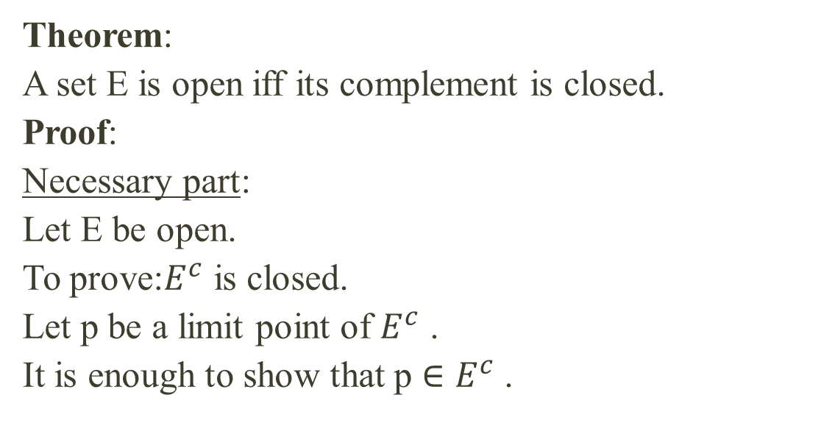
THE RELATION BETWEEN OPEN AND CLOSED SETS
Theorem:
A set E is open iff its complement is closed.
Proof:
Necessary part:
Let E be open.
To prove:$E^{c}$ is closed.
Let p be a limit point of $E^{c}$.
It is enough to show that p $∈$$E^{c}$.

Slide 18
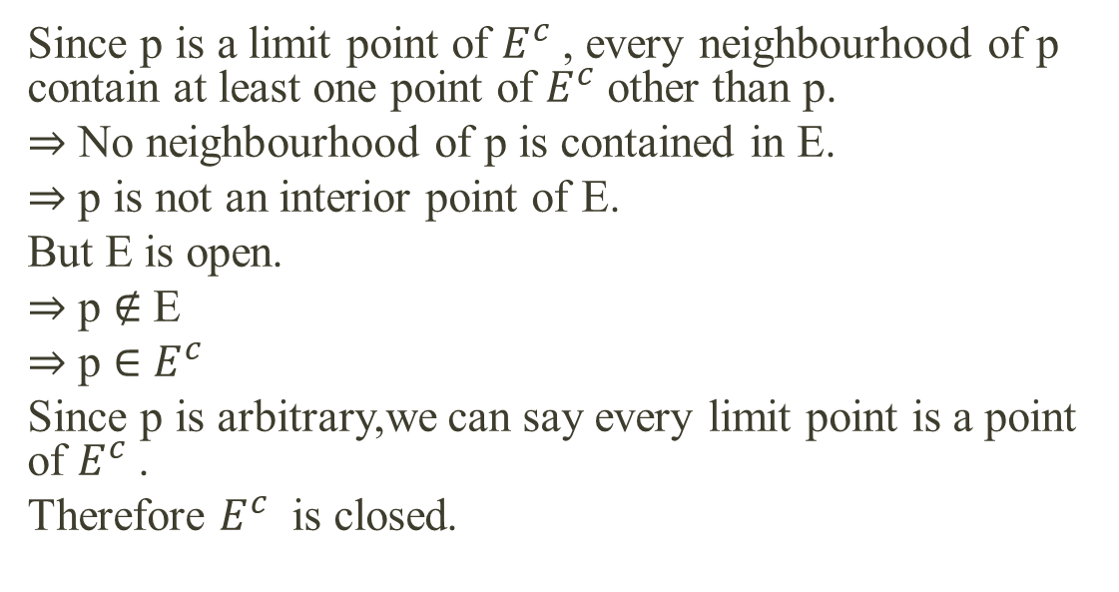
Since p is a limit point of $E^{c}$, every neighbourhood of p contain at least one point of $E^{c}$other than p.
$⇒$ No neighbourhood of p is contained in E.
$⇒$ p is not an interior point of E.
But E is open.
$⇒$ p $∉$ E
$⇒$ p $∈$$E^{c}$
Since p is arbitrary,we can say every limit point is a point of $E^{c}$.
Therefore $E^{c}$ is closed.

Slide 19
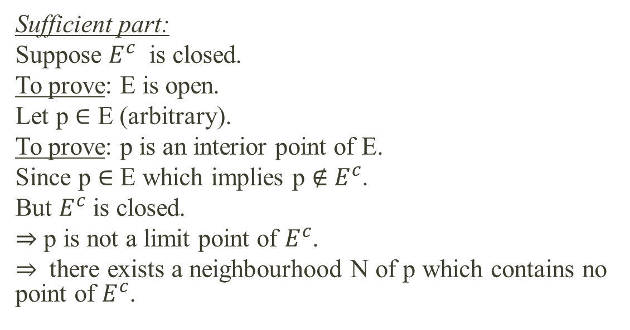
Sufficient part:
Suppose $E^{c}$ is closed.
To prove: E is open.
Let p $∈$E (arbitrary).
To prove: p is an interior point of E.
Since p $∈$E which implies p $∉$$E^{c}$.
But $E^{c}$ is closed.
$⇒$ p is not a limit point of $E^{c}$.
$⇒$ there exists a neighbourhood N of p which contains no point of $E^{c}$.

Slide 20
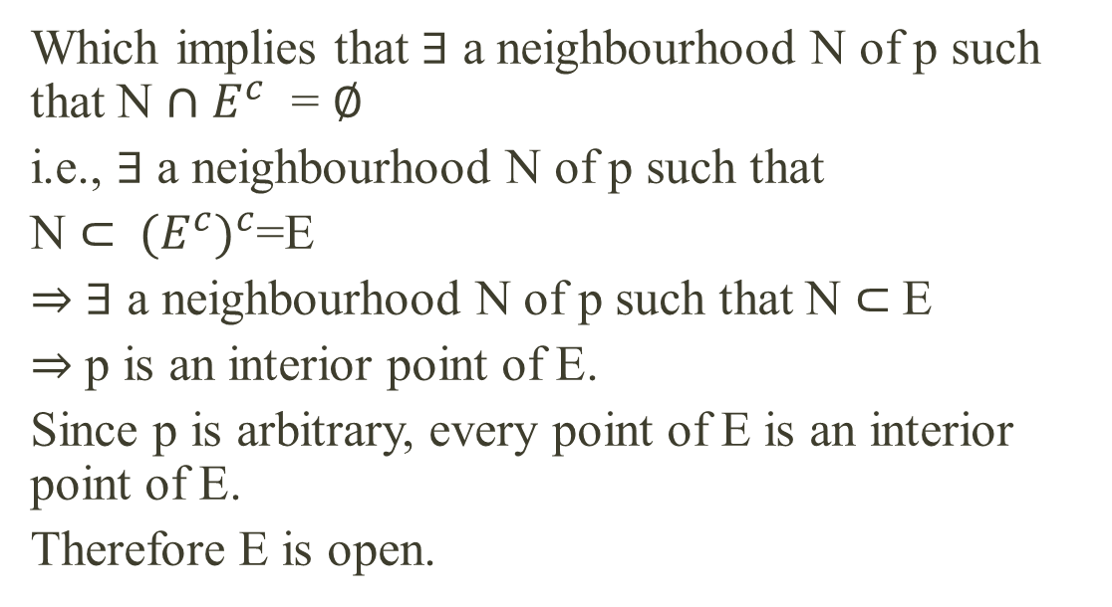
Which implies that $∃$ a neighbourhood N of p such that N $∩$$E^{c}$ = $∅$
i.e., $∃$ a neighbourhood N of p such that
N $⊂$${(E^{c})}^{c}$=E
$⇒$$∃$ a neighbourhood N of p such that N $⊂$E
$⇒$ p is an interior point of E.
Since p is arbitrary, every point of E is an interior point of E.
Therefore E is open.

Slide 21
THANK YOU

